Slide 1
ROTARY CLUB OF BURLINGTON GHANA WATER WELL PROJECT AT ESSIPON METROPOLITAN AUTHORITY SCHOOL
PRESENTER
EBENEZER K. INSOR (PASTOR)
BURLINGTON & ENGLISH SETTLEMENT UNITED METHODIST CHURCHES

Slide 2
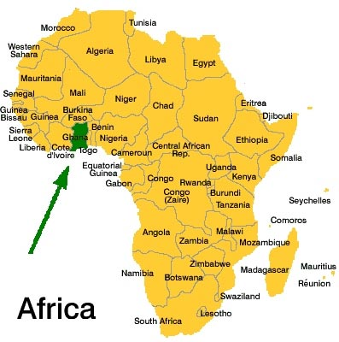
Notes:
Ghana is country on the West coast of African has highlighted in green on the map with the green arrow pointing to its location. It is bounded on the North by Burkina Faso, on the East Togo and on the La Cote de Ivoire.

Slide 3
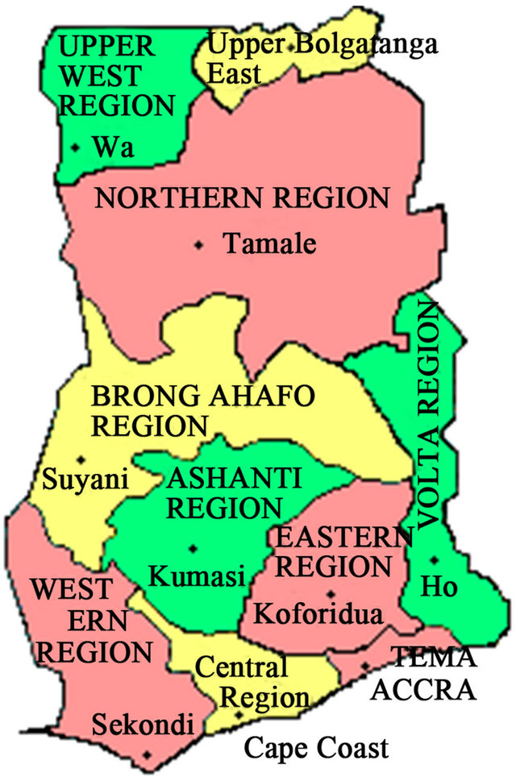
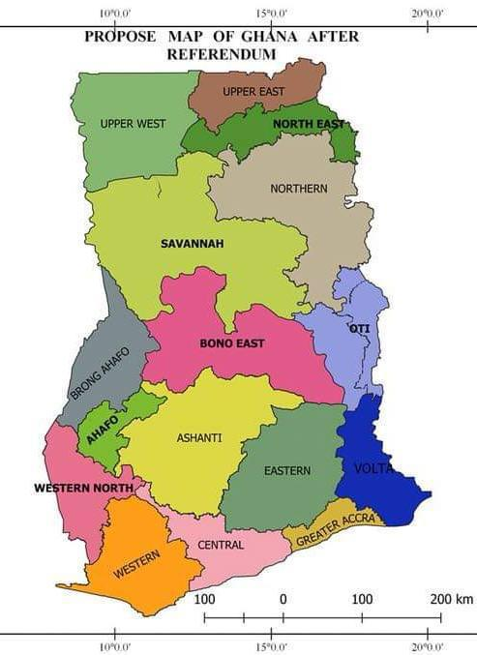
Notes:
Map of Ghana showing the new regions from 10 to 16 with the New Shama Ahanta Region where Essipon is located.

Slide 4
POLITICS AND GOVERNMENT
Ghana was the first African country to gain its independence from the British under the leadership of the late Dr. Kwame Nkrumah, who became the first president of the country in 1957 till 1966 when he was toppled by a Military coup and restored to democracy 1992. Accra is the nation’s capital and the seat of the government with other regional capitals as well as like Kumasi in the middle of the country, Sekondi-Takoradi the twin City in the west, Tamale in the north.
POPULATION AND SIZE: The country has a population of 28 million and is about the size of the state of Oregon.
Notes:
Some facts about Ghana for your information.

Slide 5
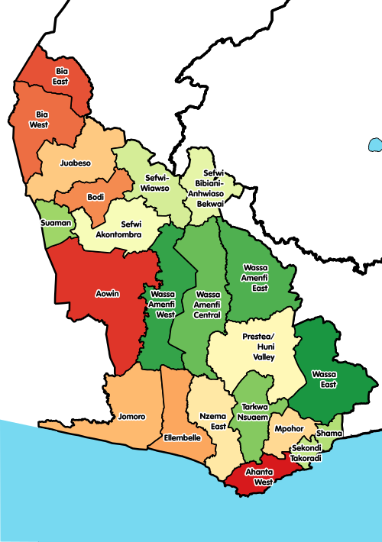
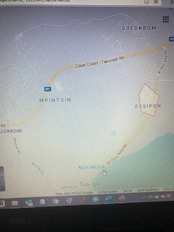
Notes:
Essipon in Shama Ahanta Region of Ghana is about 111 miles from Accra the capital of Ghana. There are seven airports closer to the city with the nearest being 8miles the Takoradi Airport.

Slide 6
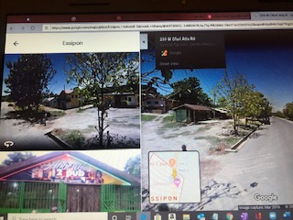
Notes:
Road Map of Essipon’s Location with a view of the town on the right.

Slide 7
NATURAL RESOURCES: Has a tropical rainforest around the west and central part of the country with coastal grassland along the coast and the savannah desert in the north. Its major crop of export is Cocoa and was once the leading producer of Cocoa in the 70’s. In addition it produces timber, palm oil and rubber for export on a smaller scale. It is a country rich in natural minerals like gold, diamond, magnesium, bauxite and oil has been found recently in the last decade.
INFRASTRUCTURE: In addition it has the largest man-made hydroelectric plant on the Volta river and two sea ports with at Tema which is the bigger one and the Takoradi harbor in the west. It also has one major international airport , the Kotoka International airport which is in the nation’s capital Accra and other small airports in Takoradi, Tamale and Kumasi.

Slide 8
TOURISM: Ghana is a great tourist destination given its historical significance in the slave trade from the 15th century marked by the Castle of Cape Coast and Elmina which were depots.
It is also known as the Black Star of Africa for its as a trail blazer in leading many African countries to independence and the founding of the Organization of African Unity, now African Union.
It also has some great wildlife and nice beaches as tourist destinations
EDUCATION: The country has a literacy rate of 56%. There has been great improvement in providing tertiary education in decades and half with the upgrading of many diploma awarding institutions to the tertiary status in addition to the three government universities which have been in existence, University of Ghana, University of Science and Technology and University of CapeCoast. Many private universities have been opened by churches and partnership with NGO’s..

Slide 9
There are secondary schools in every district in addition to private ones as well as primary education in every village. However the government’s inability to provide the basic resources needed often puts many children at a disadvantage. As such many communities rely on self-help projects and benevolence to improve and provide some of the needed resources.
RELIGION: The country has a Christian population of about 60%, with 20% muslims, 10% traditional regligion and 10% of other faiths. Among the Christians, the Catholics are the majority followed by Protestants which have the Methodist, Episcoplians and the Evangelicals, Pentecostals and Baptist

Slide 10
ESSIPON METROPOLITAN AUTHORITY SCHOOL BATHROOM CONSTRUCTION PROJECT PHASES
MISSION EXPOLRATION
PROJECT PROPOSAL AND ESTIMATES
JOINT COUNCIL APPROVAL
FUND DISBURSEMENT
PROJECT INITIATION/CONSTRUCTION
PROJECT UPDATES
PROJECT COMPLETION
PROJECT COMMISSIONING

Slide 11
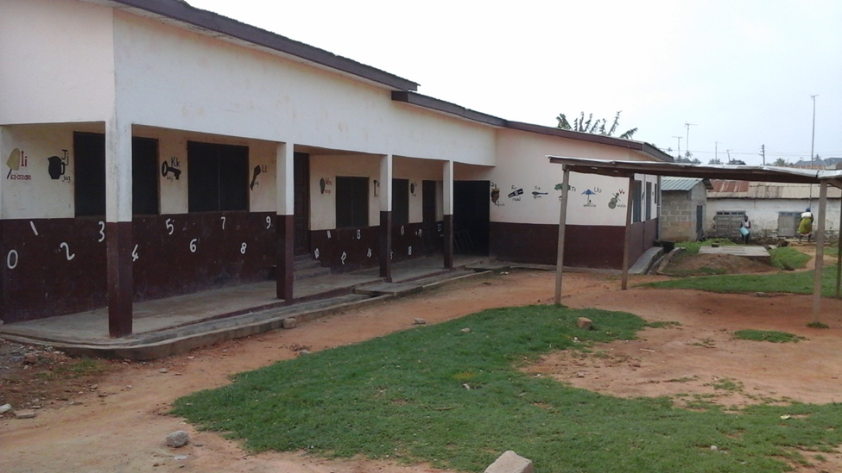
Notes:
The Kindergarten Section of the School

Slide 12
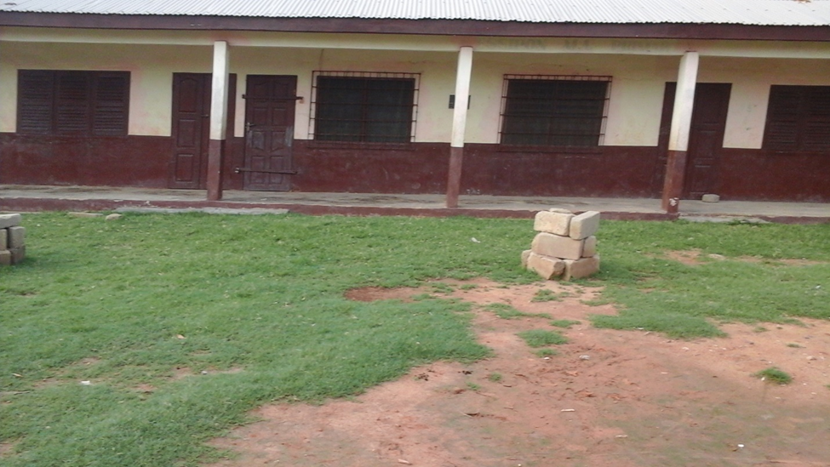
Notes:
The Junior High School Section of the Scool

Slide 13
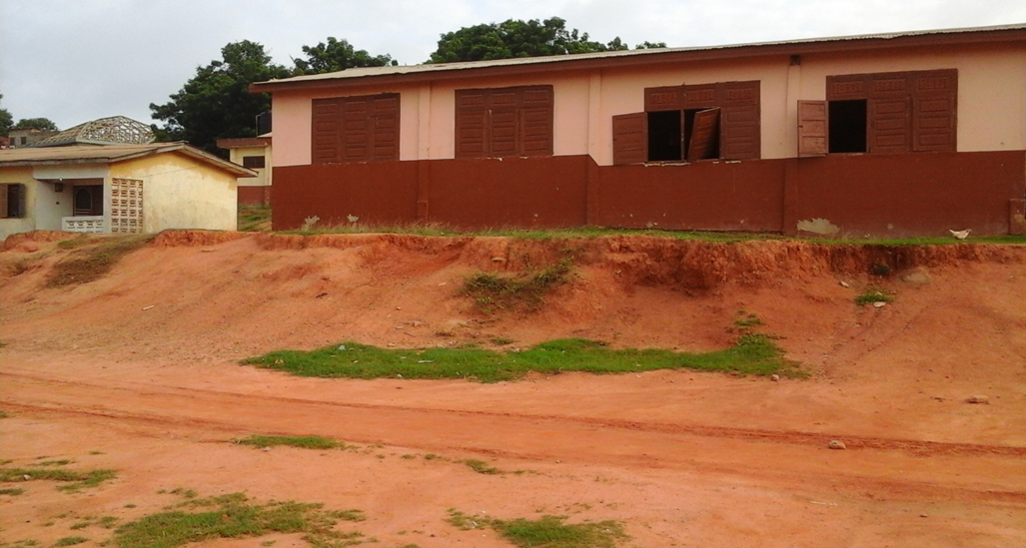

Slide 14
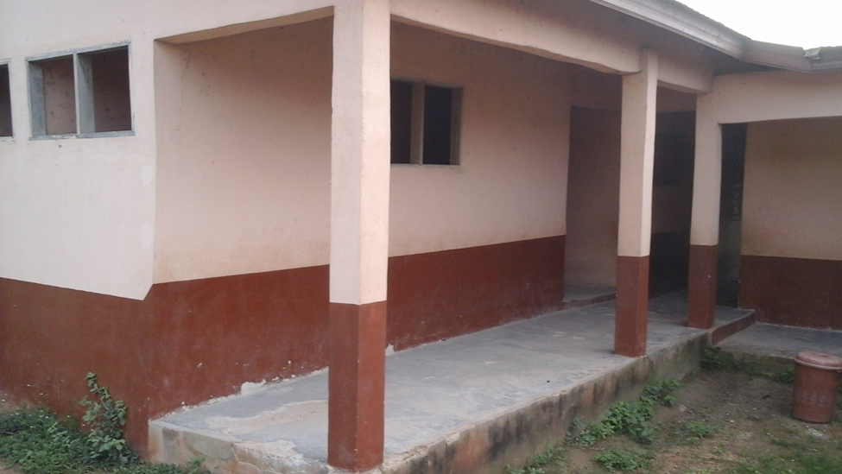
Notes:
The Elementary School Section showing the uncompleted Bathroom

Slide 15
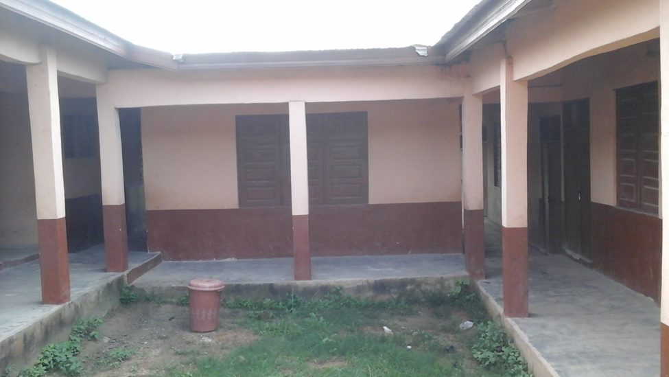

Slide 16
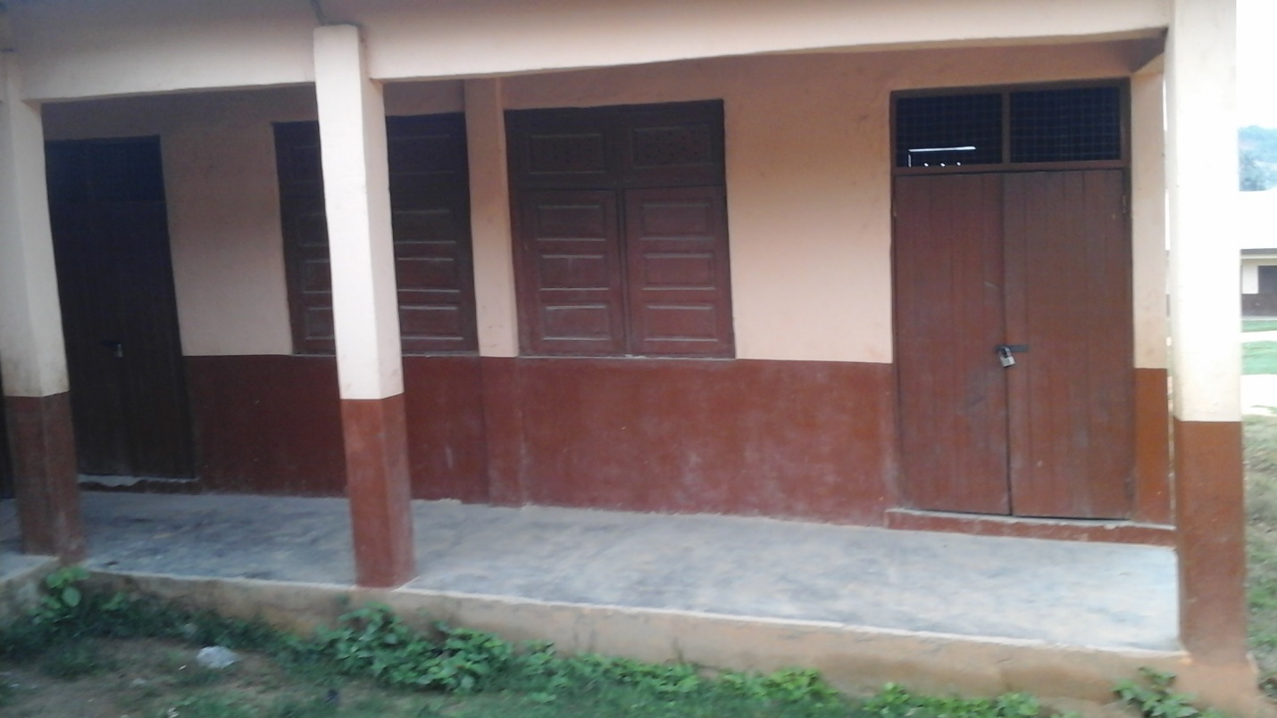

Slide 17
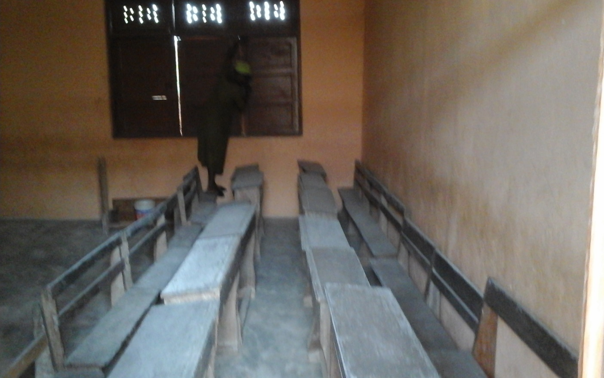

Slide 18
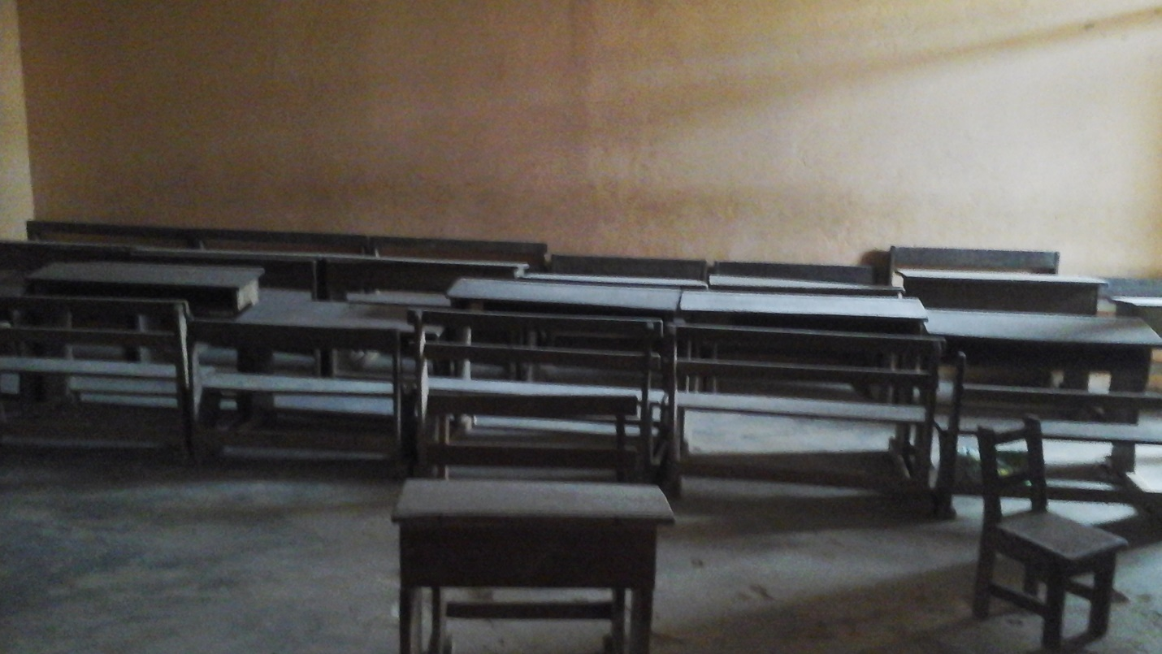
Notes:
A view of one of the classrooms with some desks

Slide 19
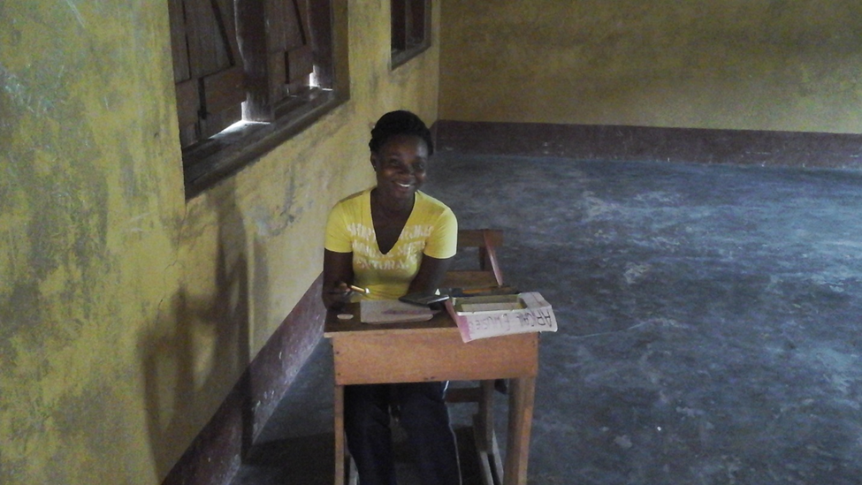
Notes:
A post high school student preparing for her entrance exam to college using an empty classroom as a study hall.

Slide 20
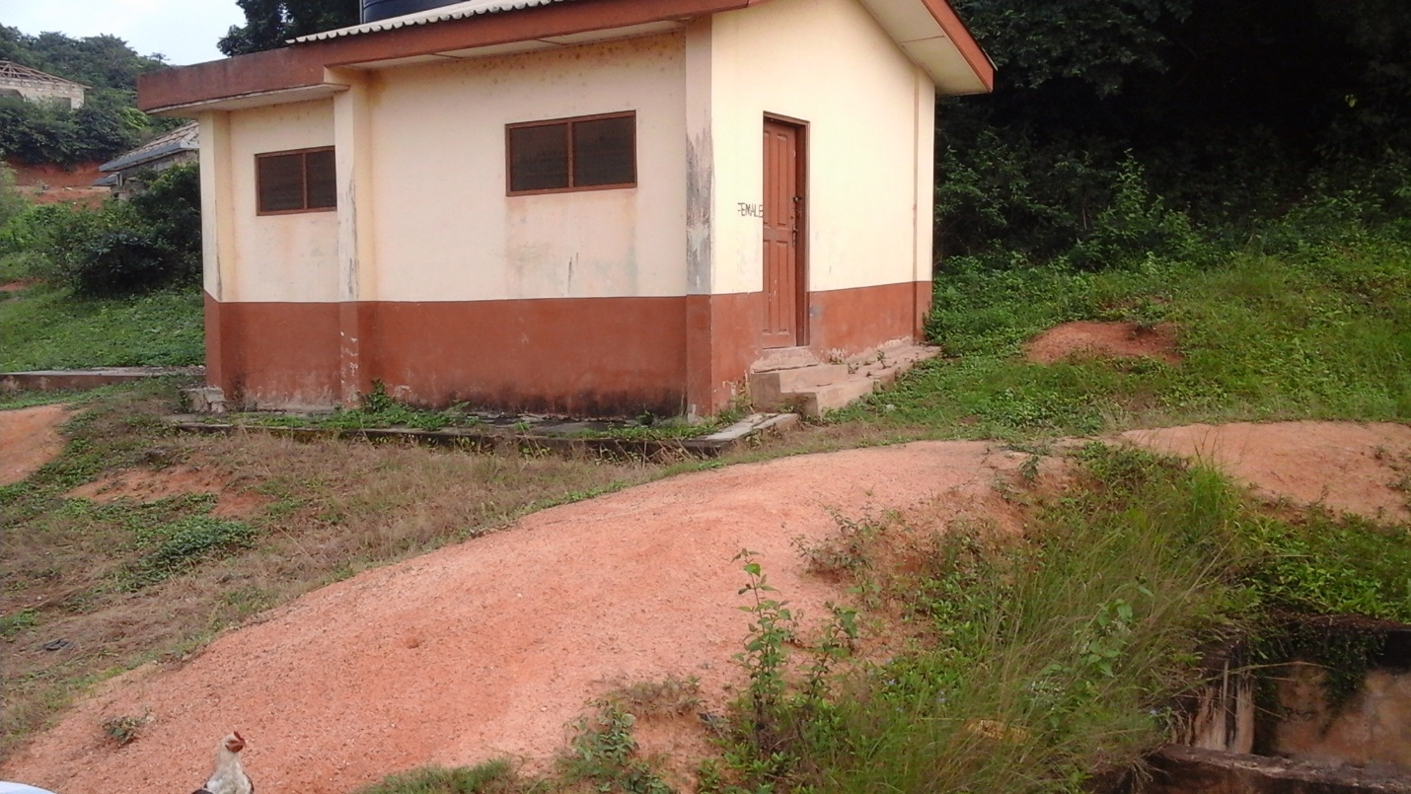
Notes:
The old bathroom constructed for the school which was inadequate and was difficult to maintain and hence became unsable.

Slide 21
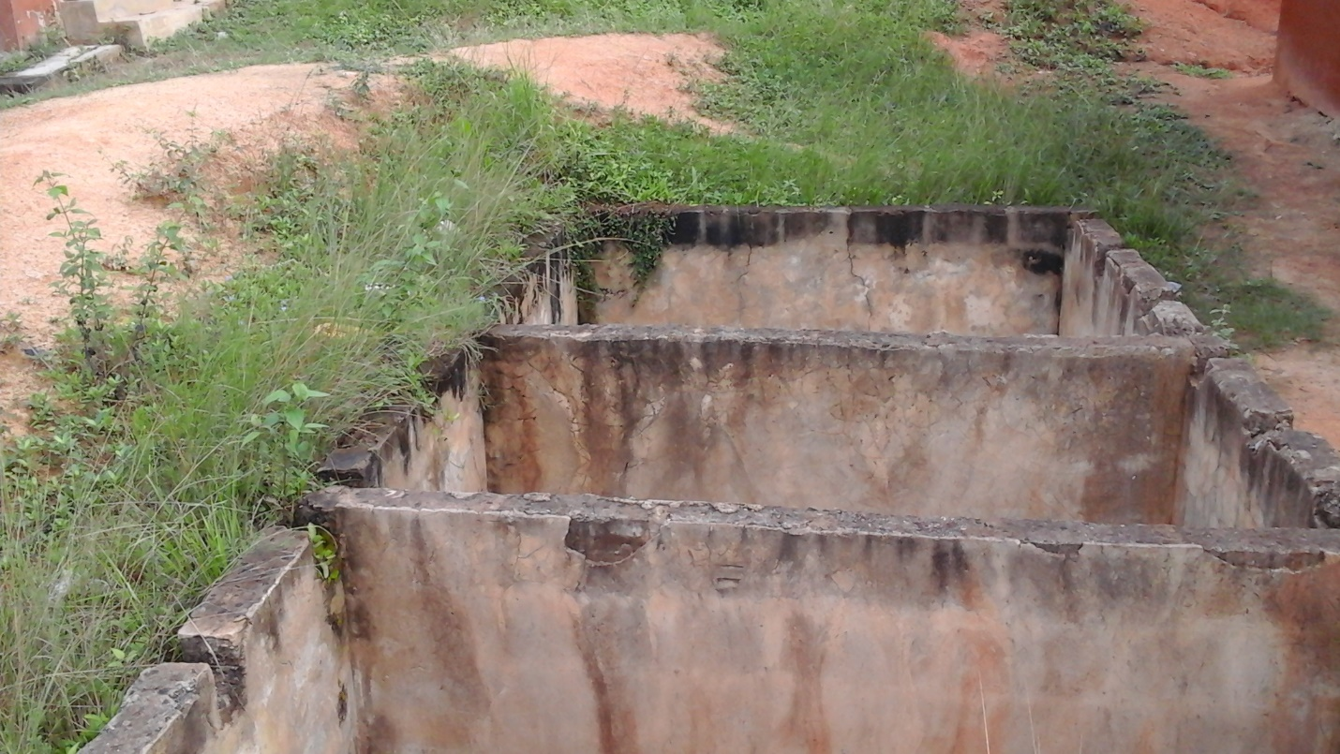
Notes:
The septic tank of the uncompleted bathroom which became a death trap killing one the children.

Slide 22
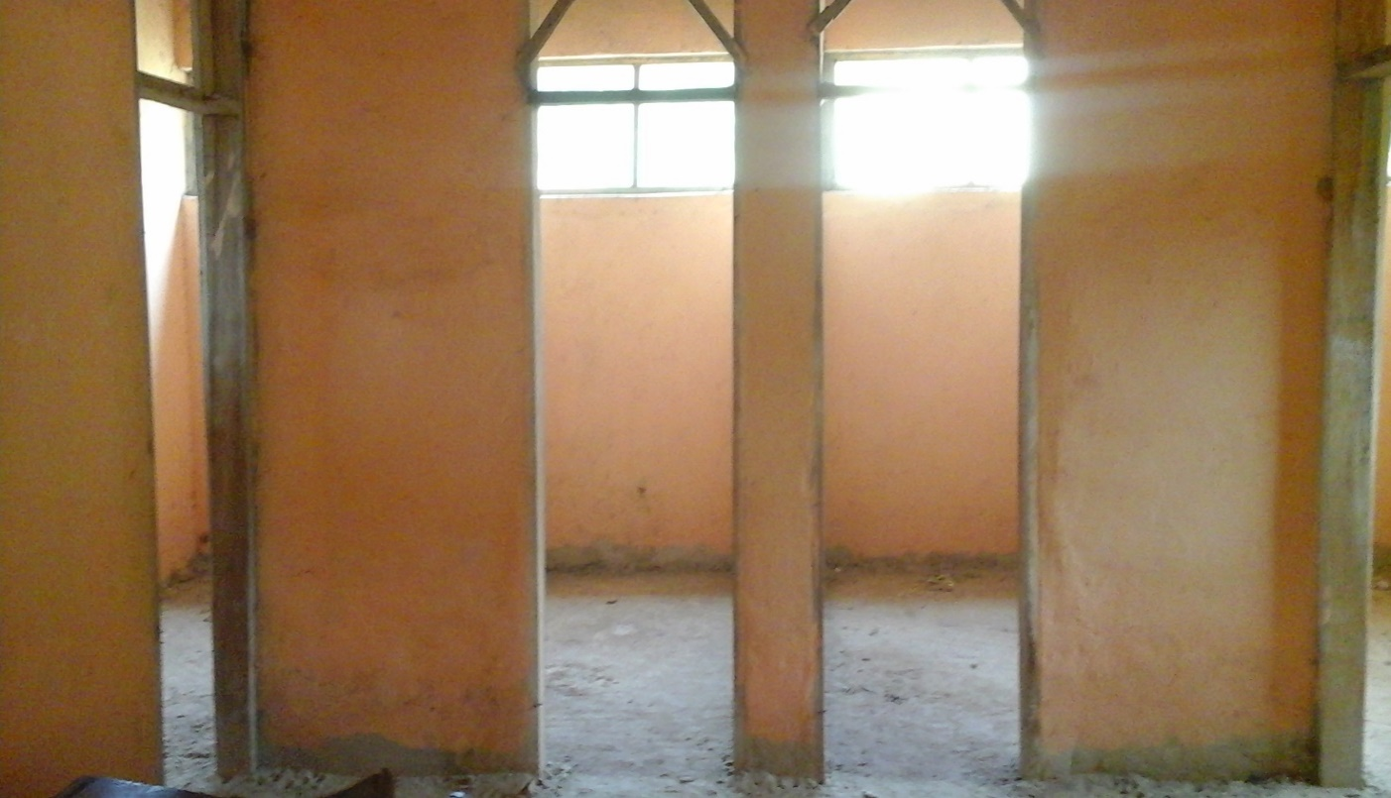
Notes:
The interior of the of the uncompleted bathroom showing the sections for toilets and unrinals.

Slide 23
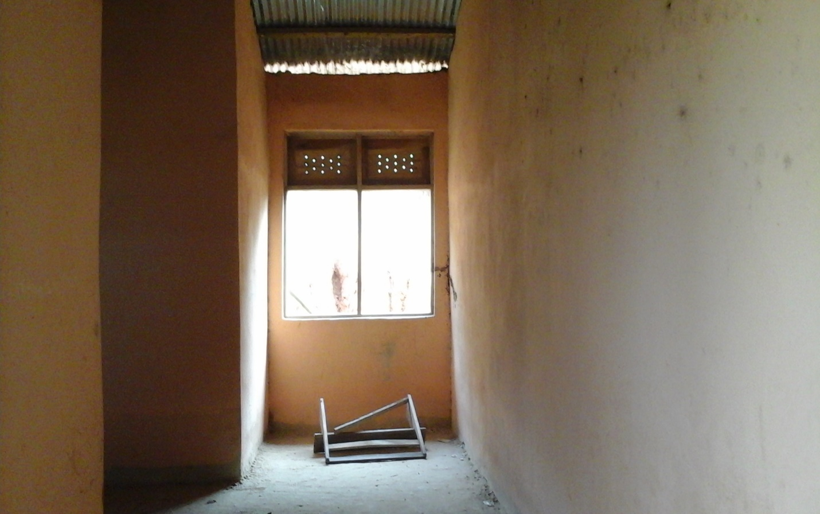

Slide 24
Construction of the Bathrooms
The septic tank
The concrete stand for the water tank
The water tank
Inside work in the bathroom, plumbing, masonry, tiling and painting

Slide 25
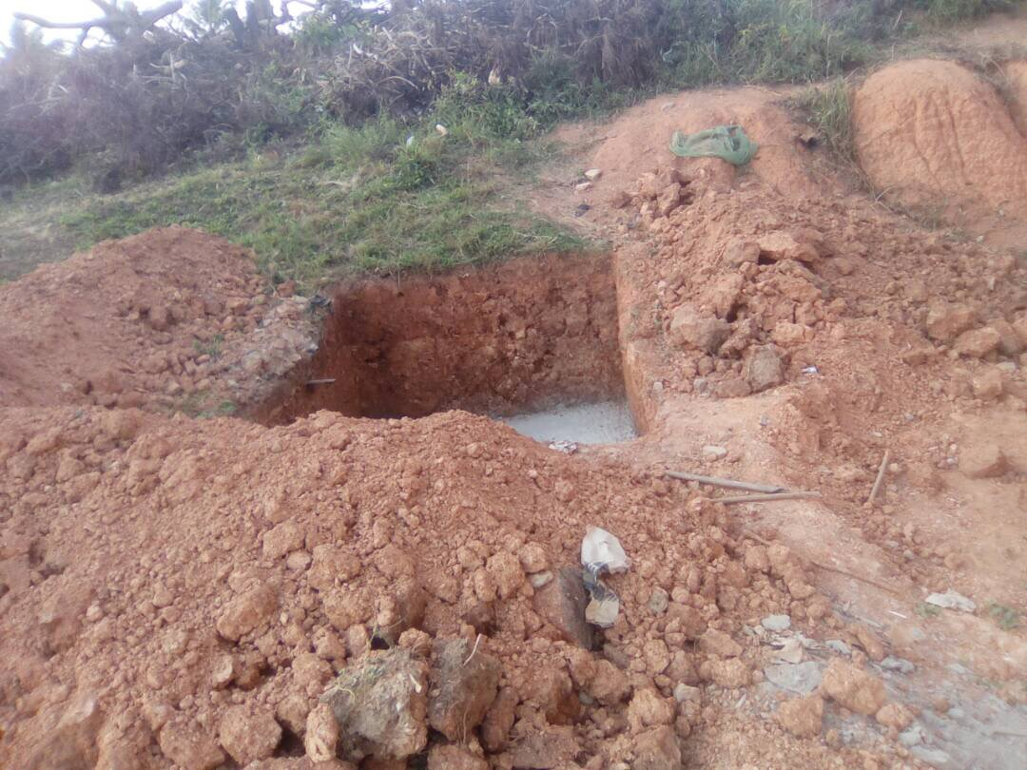
Notes:
Construction of Sewage Tank

Slide 26
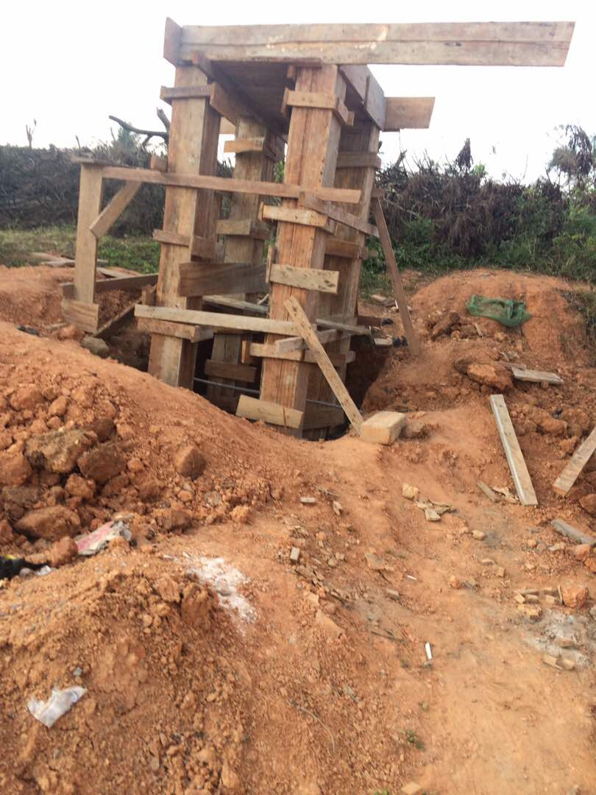
Notes:
Construction of the Platform for the Reservoir Tank

Slide 27
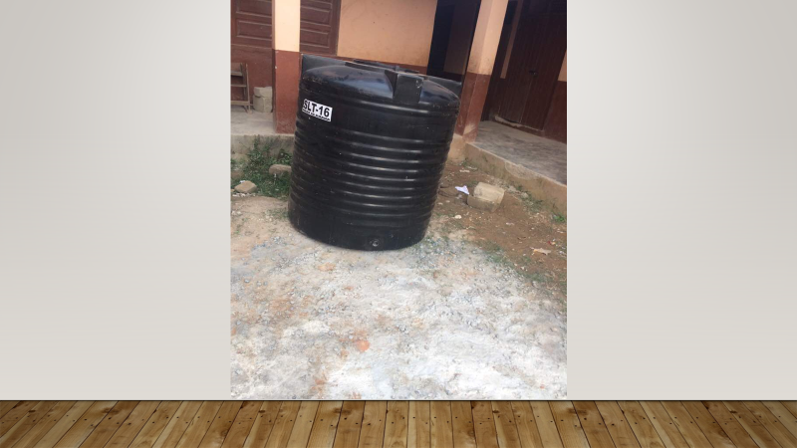

Slide 28
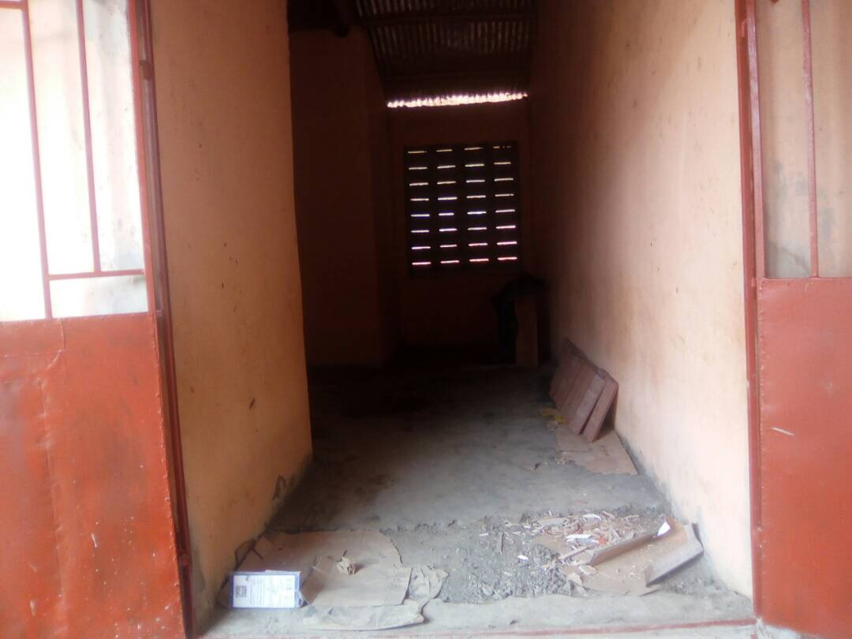
Notes:
Entrance to the Bathrooms under construction

Slide 29
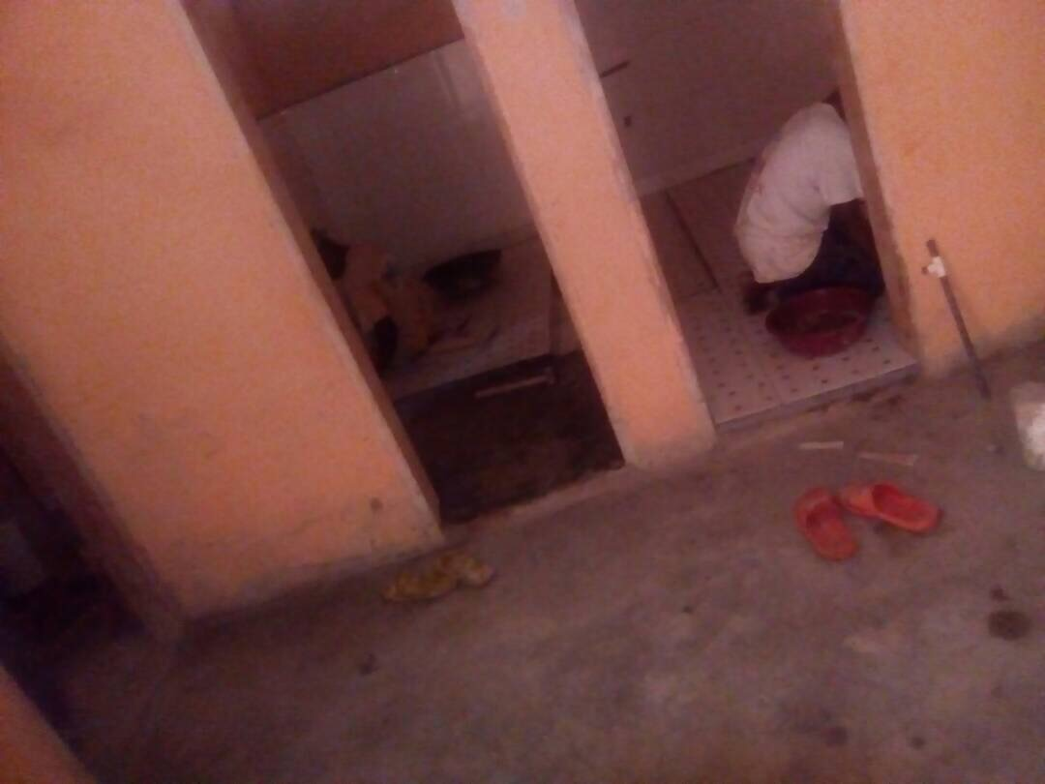
Notes:
Construction of the unrinal

Slide 30
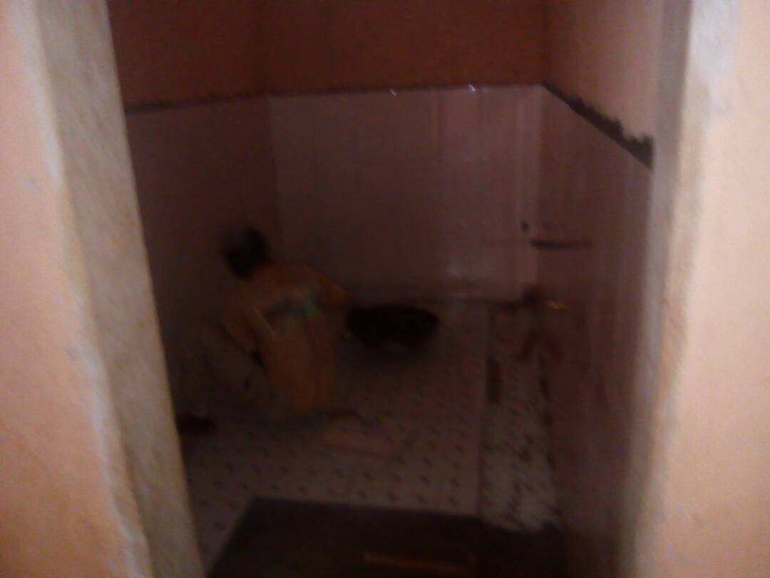
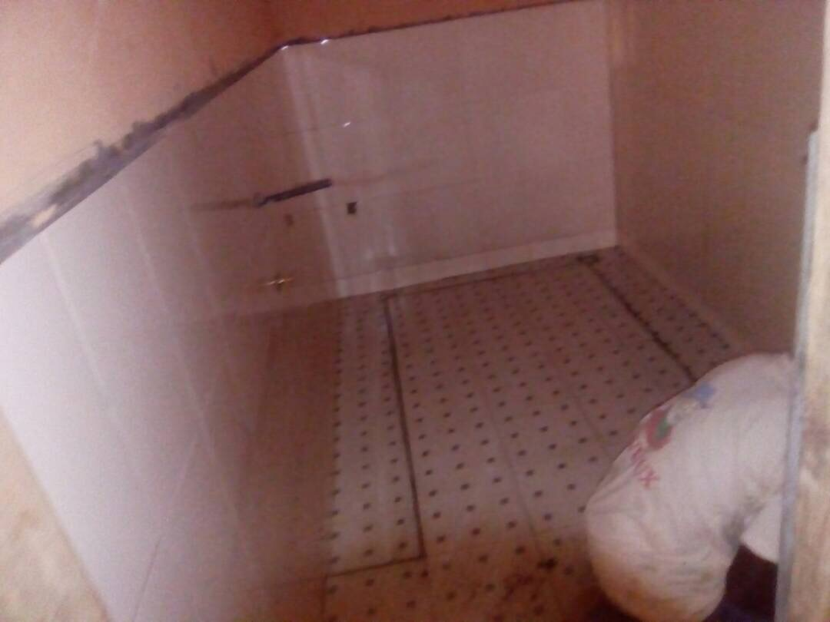
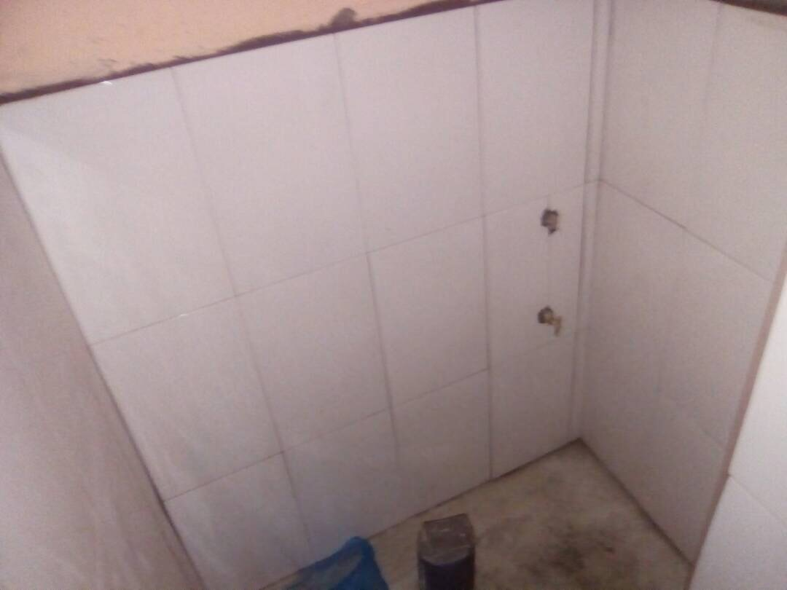
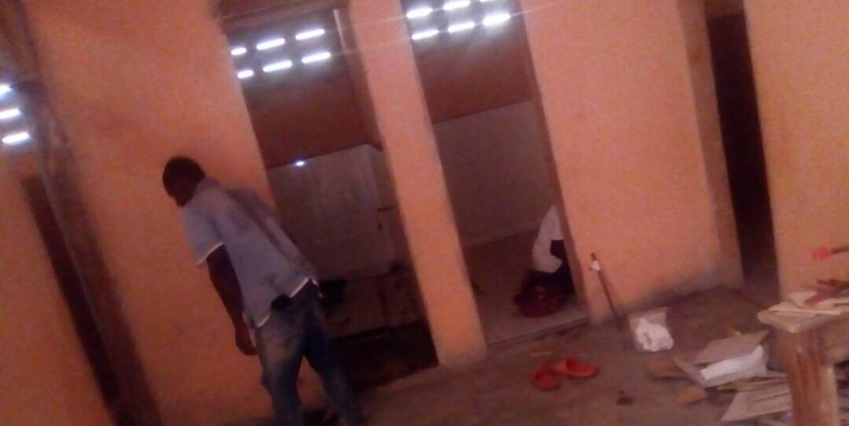
Notes:
A view of the Urinal with tiles

Slide 31
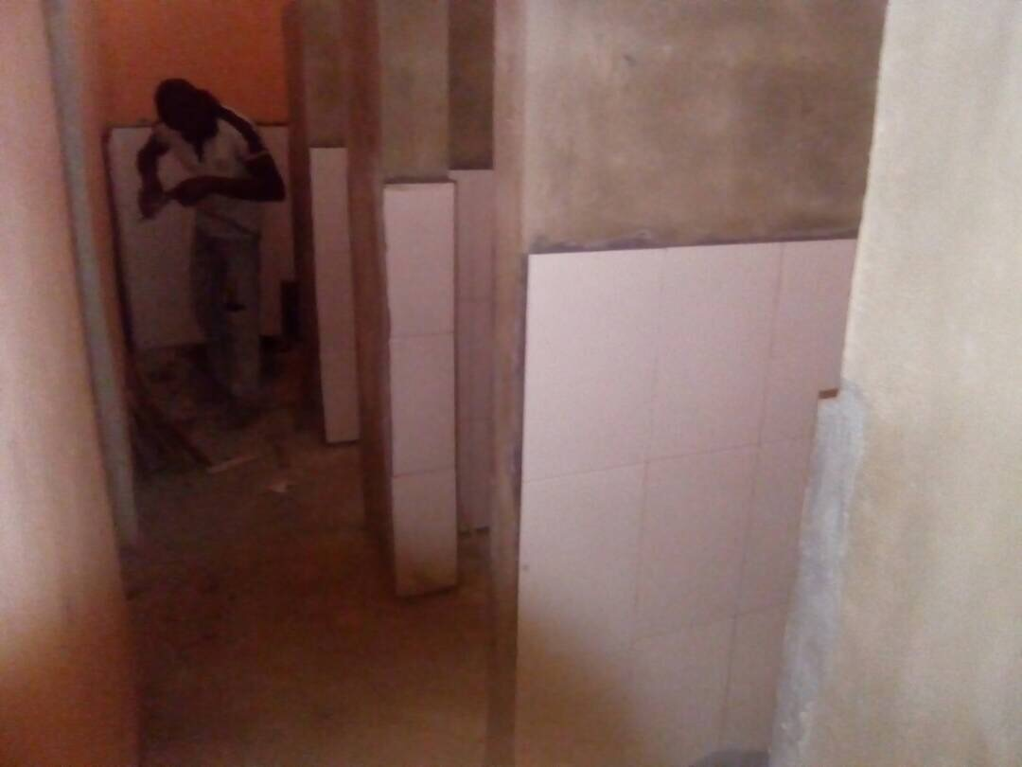

Slide 32
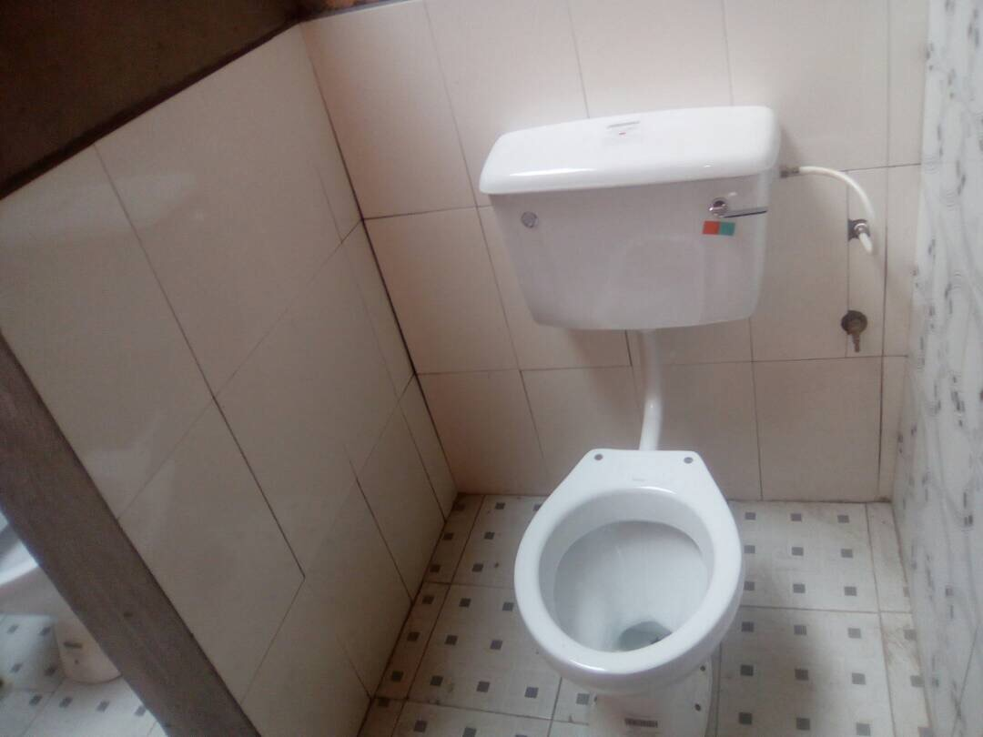
Notes:
A view of an almost completed bathroom

Slide 33
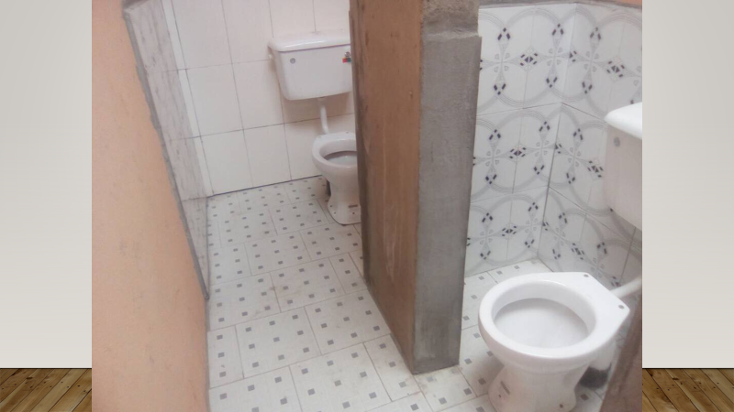

Slide 34
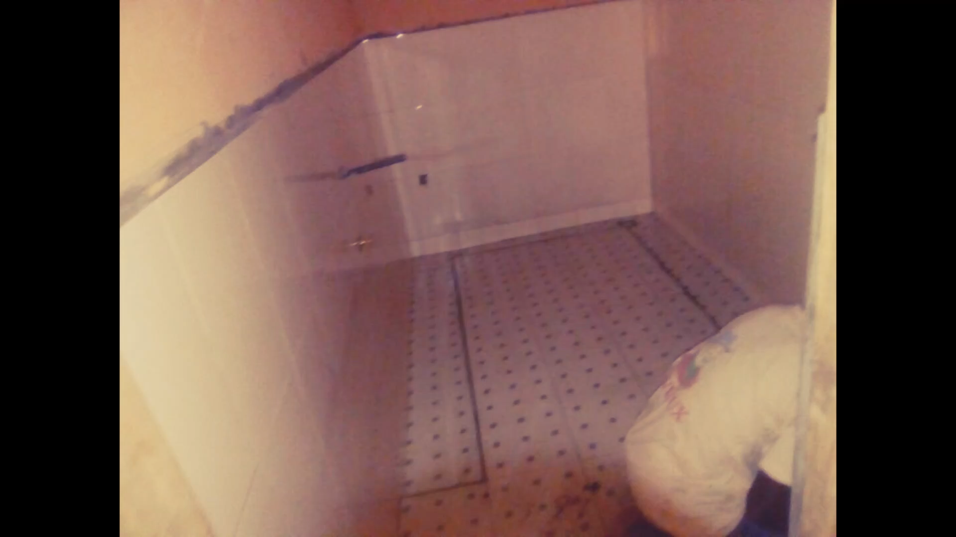

Slide 35
THE FINAL VIDEO OF THE COMPLETED BATHROOMS
PRESENTED BY
REV. LAWRENCE BLAY DANQUAH

Slide 36
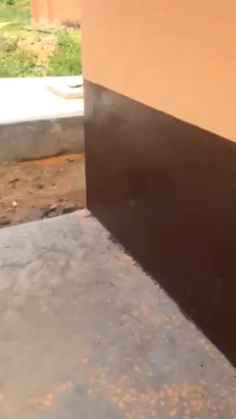

Slide 37
ROTARY WATER PROJECT INFORMATION
NEEDS ASSESSEMENT
COST OF WATER WELL
INQUIRY TO FUNDING SOURCE
DISCUSSION WITH INTERNATIONAL PROJECT DIRECTOR
DISCUSSION AT BOARDING MEETING
REQUEST FOR PRESENTATION
APPROVAL BY BOARD
APPLICATION FOR DISTRCIT GRANT
APPROVAL
FOLLOW UP WITH SEKONDI-TAKORADI ROTARY CLUB
PROJECT GROUNDBREAKING AND BEGIN DATE
PROJECT CONSTRUCTION AND COMPLETION
Notes:
Project Outline Information for the Essipon MA School Well Project in Ghana

Slide 38
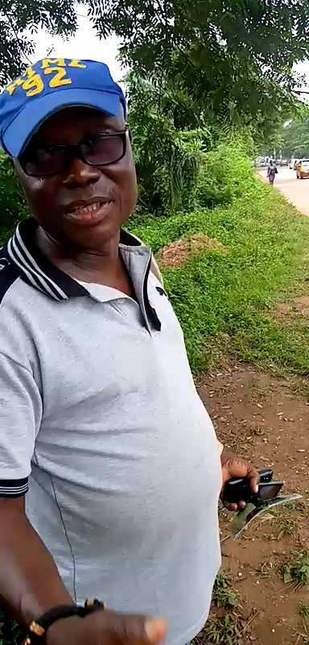
Notes:
This is a short video explanation from the contractor about the drilling of the borehole project.

Slide 39
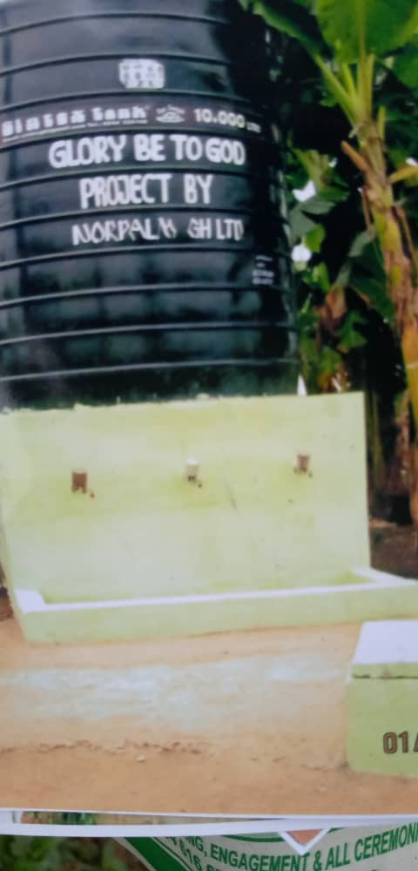

Slide 40
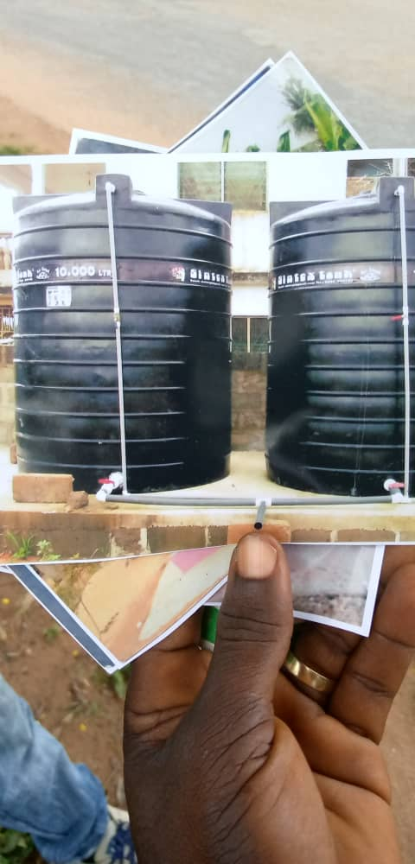

Slide 41
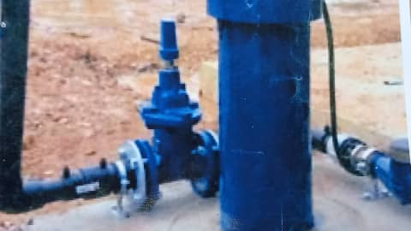
Notes:
A Sample of the Water Pump System Design for the Essipon MA School Water Well Project.

Slide 42
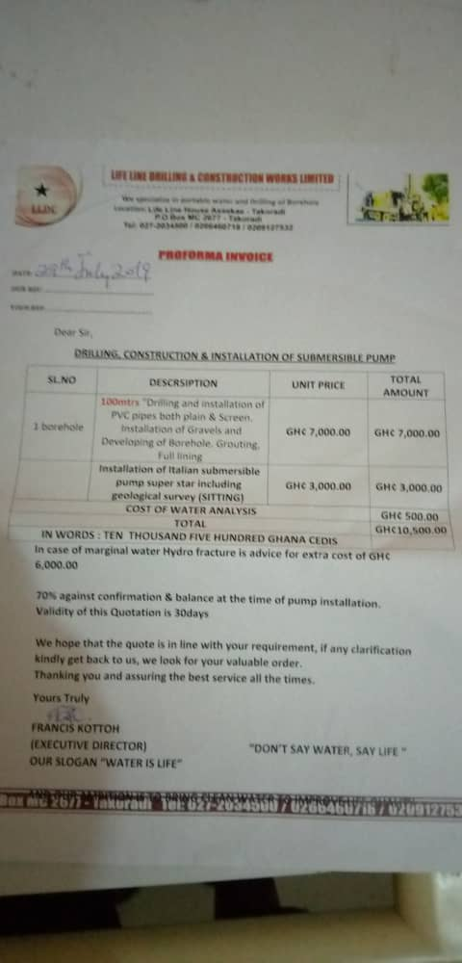
Notes:
Receipt for the Cost of Drilling for water and installation of pump and filtration of water costing 10,500 Ghana cedis ~ $2,019.23

Slide 43
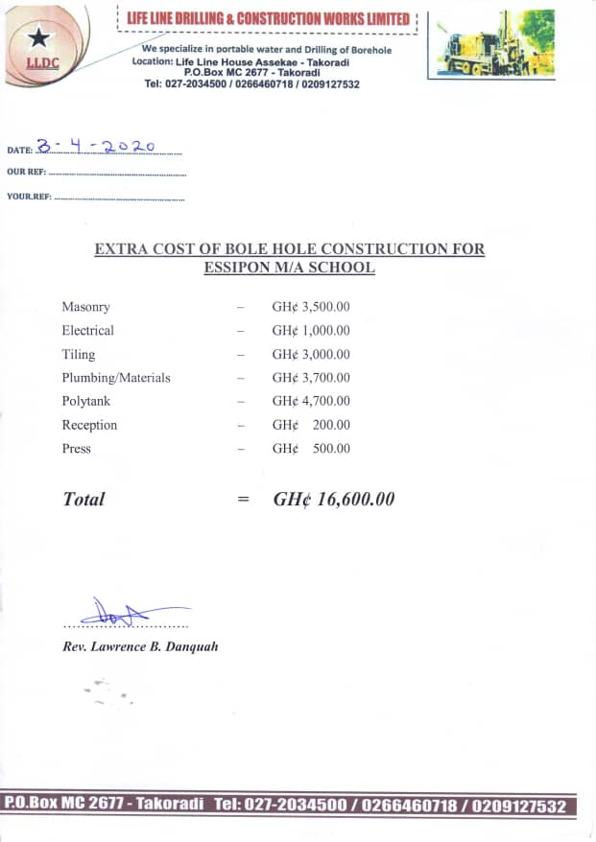
Notes:
In addition another 16.600 Ghana cedis was spent in site construction and preparation as broken down below
Masonry work – 3500 =653.84
Plumbing work -Gh3700.00 =711.53
Electrical -Gh1000.00 =192.30
Cost of Tank -Gh4700.00 =903.84
Tiling -Gh3000.00 =576.92
Press Coverage -Gh$500.00 = 96.12
Reception -Gh$200.00 =38.46
Bring the total costs of the project to ~$5,300.00

Slide 44
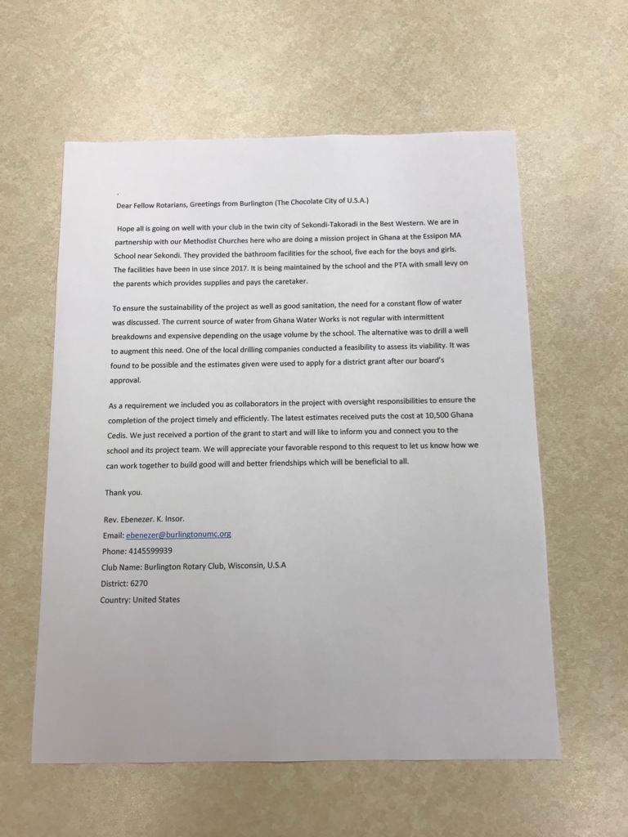
Notes:
Letter sent to the Sekondi-Takoradi Rotary Club seeking their collaboration in the Essipon MA School Water Well Project
on behalf of Burlington Rotary Club by Ebenezer Insor

Slide 45
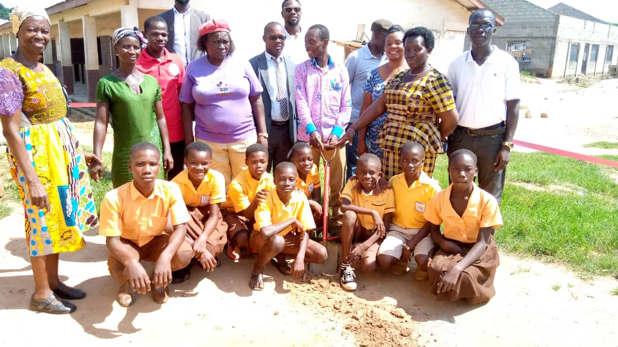
Notes:
Ground Breaking Ceremony for the Beginning of the Burlington Rotary Club Water Project at Essipon MA School Ghana West Africa.

Slide 46
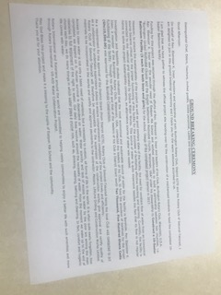
Notes:
Ground Breaking Ceremony Address made by the President of the Sekondi -Takoradi Rotary Club
on behalf of Burlington Rotary Club and District 6270 for the Water Well Project at Essipon MA School.

Slide 47
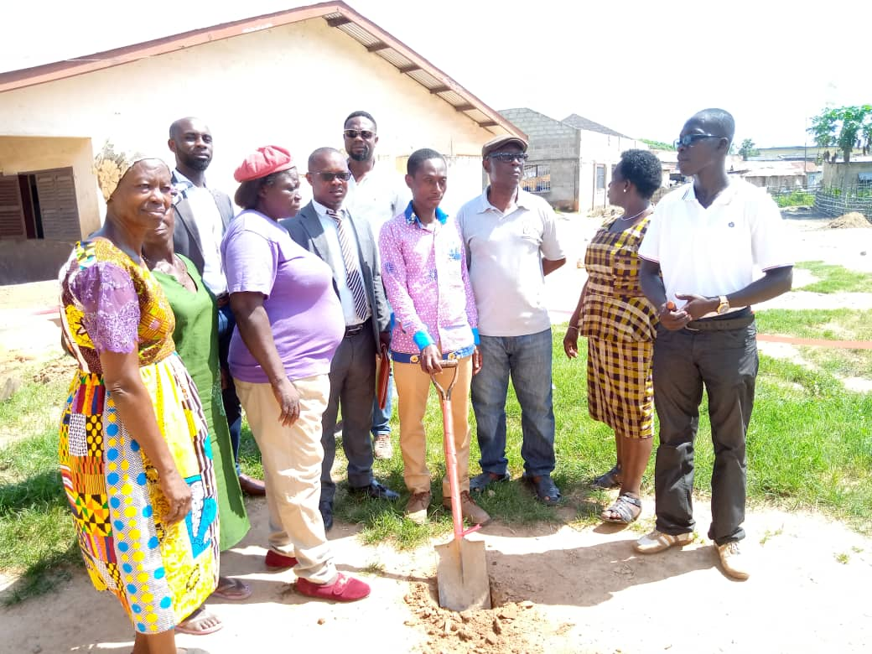


Slide 48
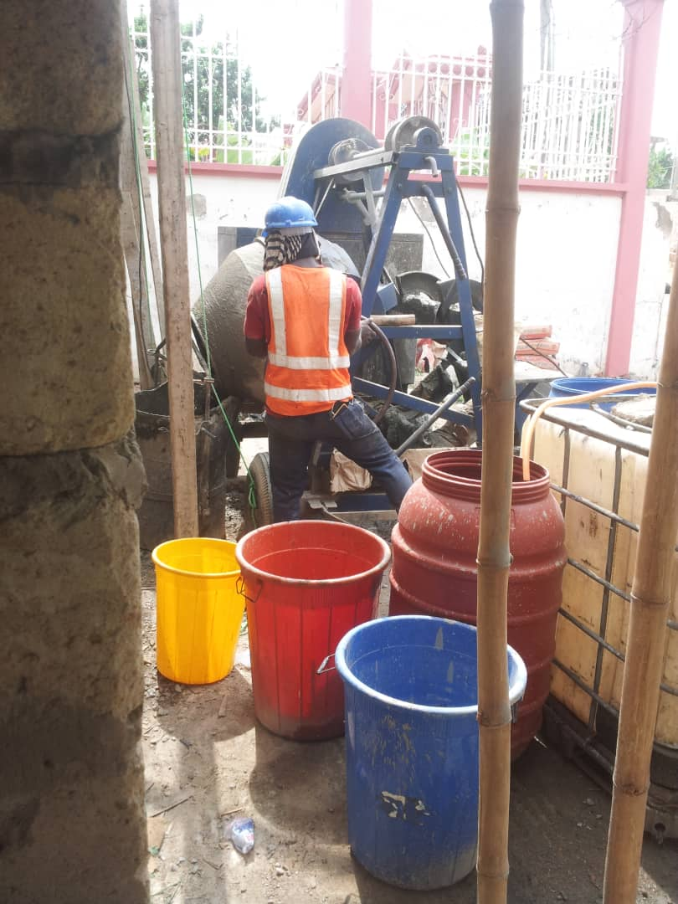
Notes:
Drilling of the ground for the water well project at Essipon MA School in Ghana

Slide 49
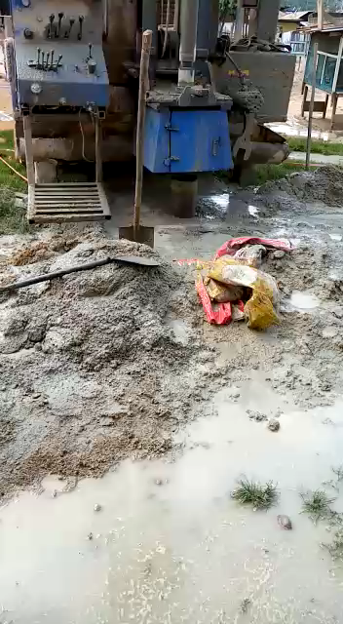
Notes:
Drilling and Construction work at the Essipon MA School Water Well Project in Ghana

Slide 50
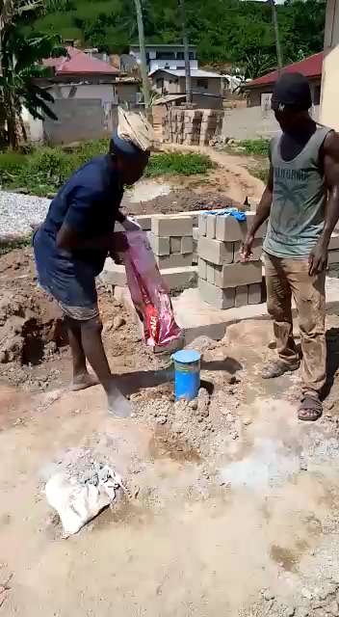
Notes:
Installation of the Water Pump at the Essipon MA School Water Well Project In Ghana.

Slide 51
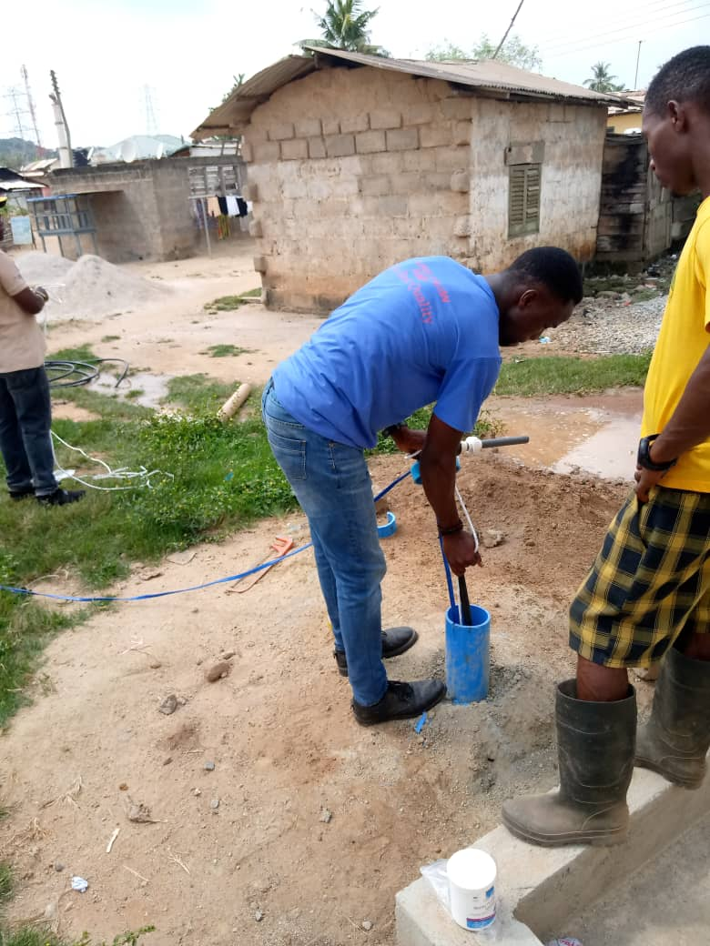

Slide 52
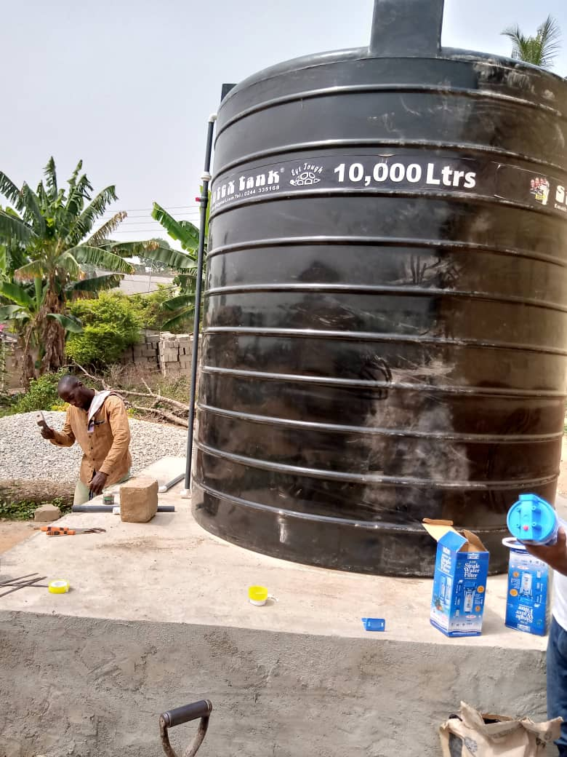
Notes:
Plumbing Work at the Essipon MA School Water Well Project in Ghana

Slide 53
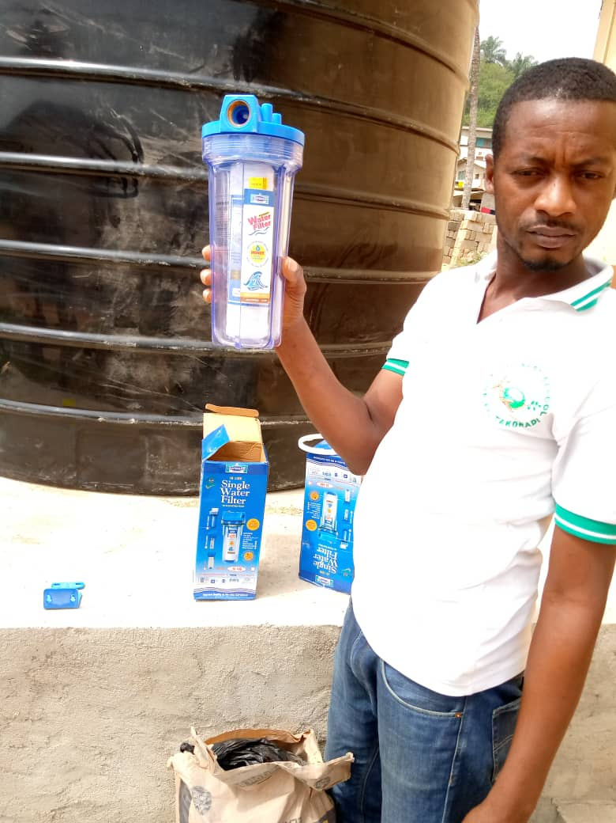
Notes:
A Display of the Water Filtration System at the Essipon MA School Water Well Project Site

Slide 54
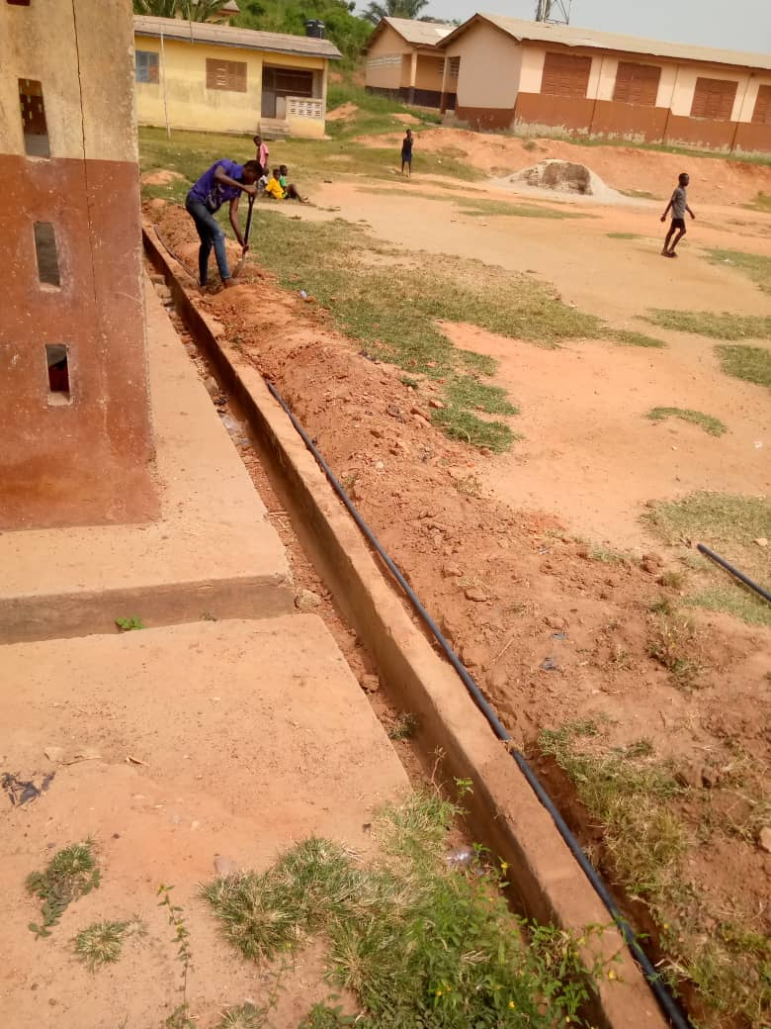
Notes:
Digging the trench for the pipeline to connect the well to the Bathroom at the Essipon MA Water Well Project site.

Slide 55

Notes:
Digging the trench to connect the electrical cable to the pump at the Essipon MA School Water Project Site.

Slide 56

Notes:
Laying of tiles on the tank platform and pipestand at the Essipon MA School Water Well Project site.

Slide 57

Notes:
A view of the pipe stand and the pump and the tank platform of the Essipon MA Water Well Project

Slide 58

Notes:
A view of the tiled tank platform area of the Essipon MA School Water Well Project.

Slide 59

Notes:
Completed View of Essipon MA Water Well project showing the tiled pipe stand, the water filters and the tank for the storage of the water with part of the village in the back ground.

Slide 60

Notes:
Completed view of the Essipon MA School Water Well Project showing the pipestand area, the pump enclosed in a concrete case and the filters.

